Slide 1
Asset Management Snipe-it
Julien Koerber
Molsheim, 28th of March 2025

Slide 2
Context of the activity
01

Slide 3


Context of the activity
The PoC aims to prove that an integrated solution can work for our R&D bioprocess platform.
Validate the automation and centralized management of equipment across the DI platform.
In this context, the focus is on deploying a prototype that automatically searches for industrial devices on the network. This prototype should continuously scan the network, detect active devices, and centralize their data within an asset manager, all while ensuring secure data transfers.

Slide 4
Concept & Demo Covered topics
Architecture Runway
Network
Smart
components
NIIMBL
Project management
Artificial Intelligence
Data
Robotic
Consortia
MBSE
UX
Support
Monitoring
Cloud
OT/IT
Standards
Collaboration
Front end
Ontology

Slide 5

Objective
First impression of what the AM software will look:
- User Interface
- Asset inventory / tracking
- User management
Explain what is an Asset Management
What are the benefits

Slide 6
Objectives of my project (prototype)
Julien
Propose a prototype for automatic discovery of industrial devices on a network and their registration in an asset management system:
Interact with OPC UA servers
Data collection
Integration and storage (snipe-it)
Asset Check-in & Check-out
Notes:
Speaker:
Have a smooth workflow to design a model of a control up to its deployment.

Slide 7
what is « Asset Management » ?
02

Slide 8




Asset Management: What is it ?
Julien
The actual problem in DI is that the Smart Components are not really organized.
Lack of Visibility → the team do not have all the information about a Smart Component. So, it’s difficult to make decisions about allocation.
Ineffective Planning → A lack of data on asset performance can hinder strategic planning.
Inefficiency → Without proper tracking, the team may struggle to locate equipment, so they waste a lot of time.
Reduce Accountability → Without a clear system of tracking who is using which asset, it can lead to potential misuse or loss of equipment.
Notes:
Speaker:
Have a smooth workflow to design a model of a control up to its deployment.

Slide 9

Asset Management: What is it ?
Julien
Asset management involves cataloging, tracking, and optimizing the management of an organization's equipment and resources to maximize their performance and overall value.
I’m using Snipe-it to evaluate and propose this solution. Snipe-it is an open-source software that facilitates IT asset management by enabling organizations to track asset details such as condition, location, and assigned users. It also supports software license management and maintenance tracking, allowing for better oversight and optimization of asset use.
I’m going to explain you all the features that Snipe-it is supporting!
Notes:
Speaker:
Have a smooth workflow to design a model of a control up to its deployment.

Slide 10
Asset Management: What is it ? Presenting Snipe-it
Julien
Main features of Snipe-it related to asset management:
Asset Tracking: location of the asset
Check-out / Check-in: Users can reserve assets for a specified duration and return them
Reporting and Analytics: The platform offers reporting tools to analyze asset usage
User Management: Administrators can manage user roles and permissions. Team member have appropriate access to asset information
Custom Fields: Users can create custom fields to capture additional information
Notes:
Speaker:
Have a smooth workflow to design a model of a control up to its deployment.

Slide 11
Asset Management in Digital Innovation
03

Slide 12

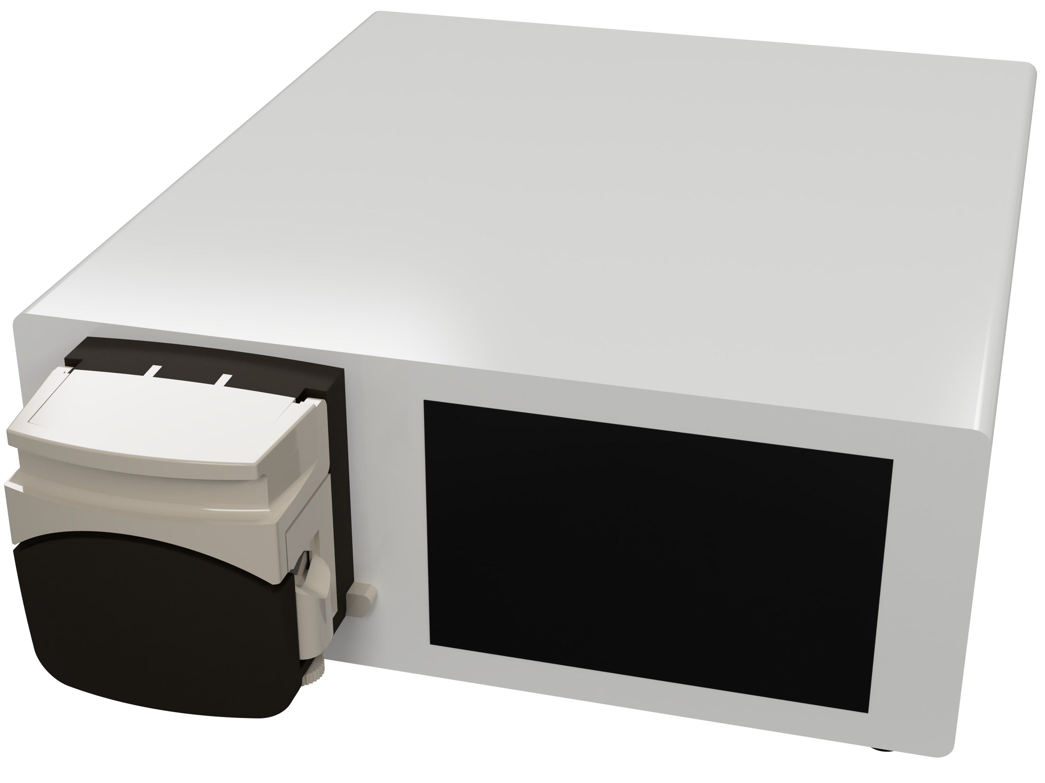
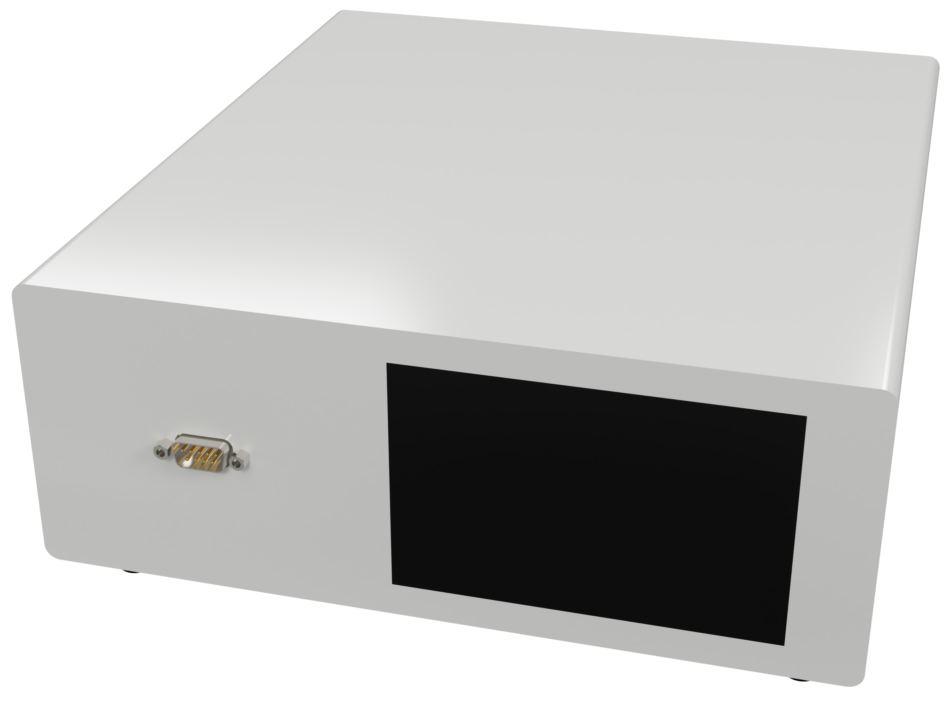
Asset Management in Digital Innovation
Julien
Asset management will be very useful in the DI team, particularly for centralizing the management of all Smart Components in one place.
Each person will be able to reserve a Smart Component, knowing which Bench it is located on for a specified duration, and then return it for use by other team members.
Summarize all the SC in one API
SC1
SC2
SC3
SC4
Notes:
Speaker:
Have a smooth workflow to design a model of a control up to its deployment.

Slide 13
Mid-internship demonstration of my project
04

Slide 14
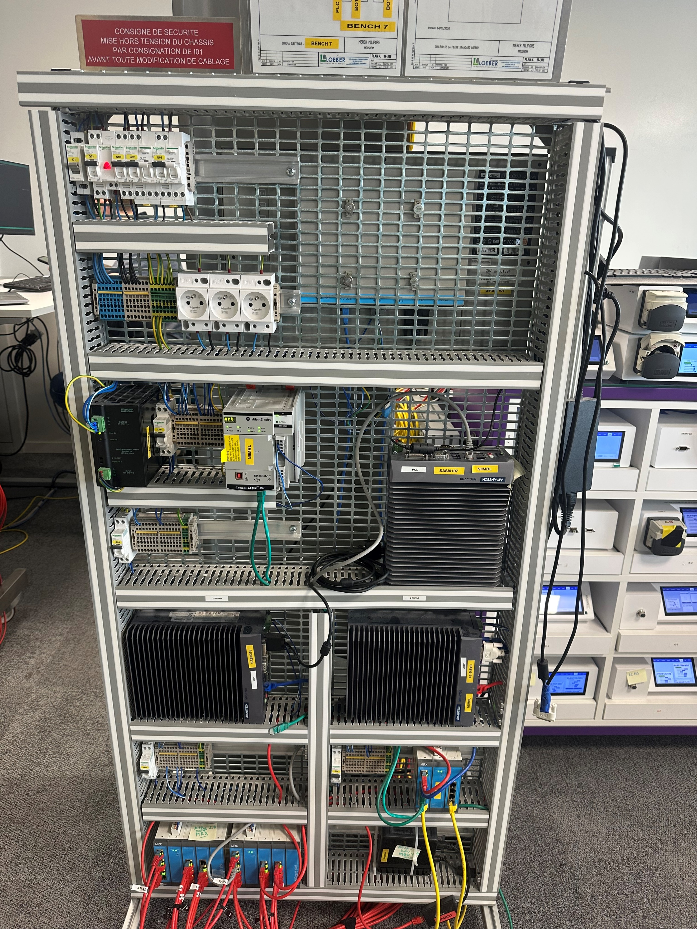
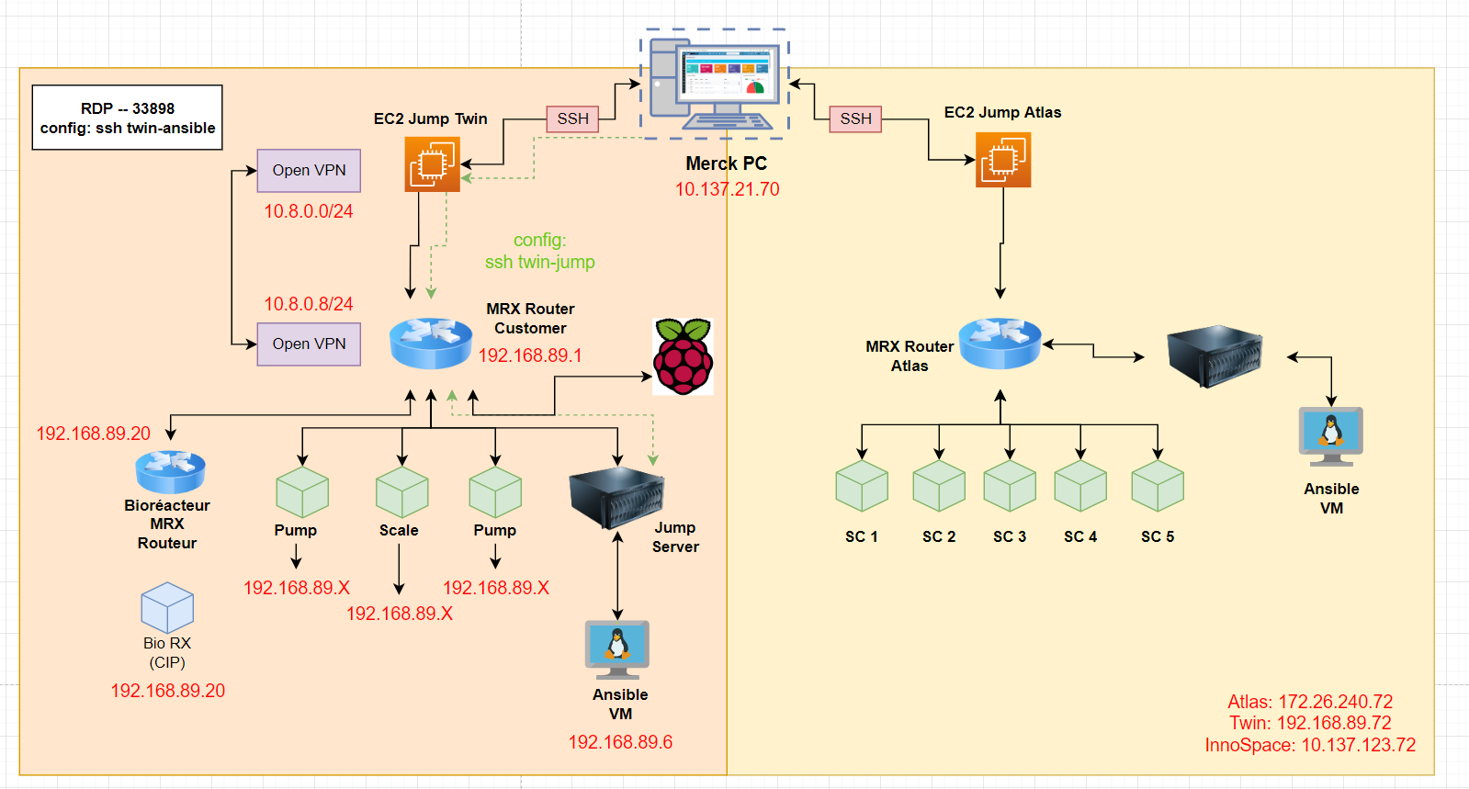
Diagram of the Twin Bench
POC environnement

Slide 15
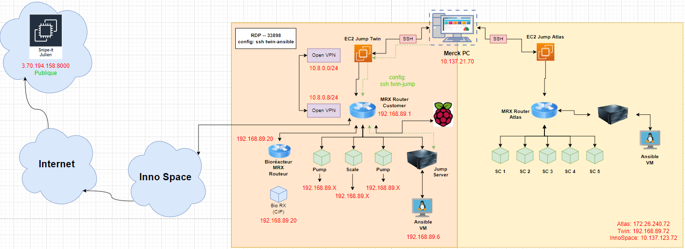
Diagram of the Twin Bench with my EC2
POC environnement
nmap -n -p 4840 --open $(IP_ADDR)/24 -oG - |
awk '/4840\/open/{print $$2}’ |
python3 demo.py --list --location "Twin-Bench"

Slide 16
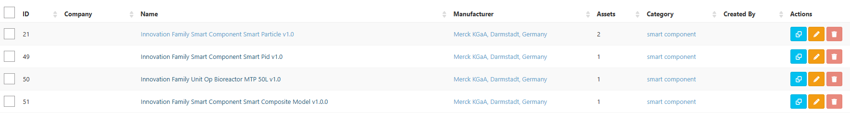
Smart Component found → Creating Asset
POC environnement
Asset Models
Manufacturer

Slide 17


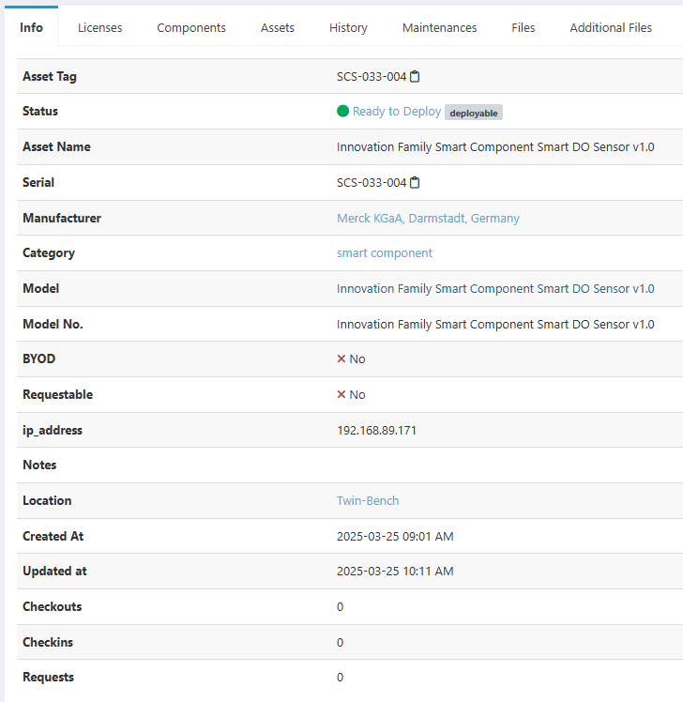
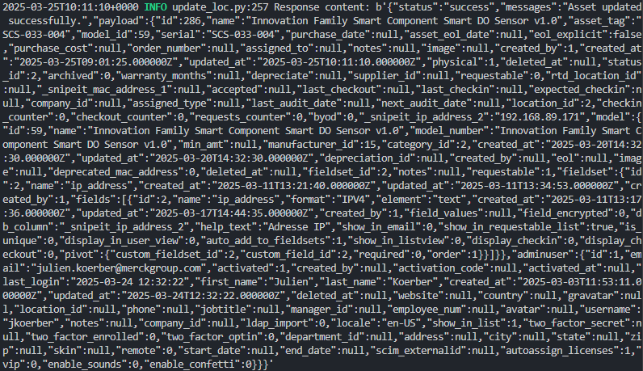
Smart Component found → Asset created
POC environnement
Snipe-it
This is what happened when a new Smart Component is discovered

Slide 18
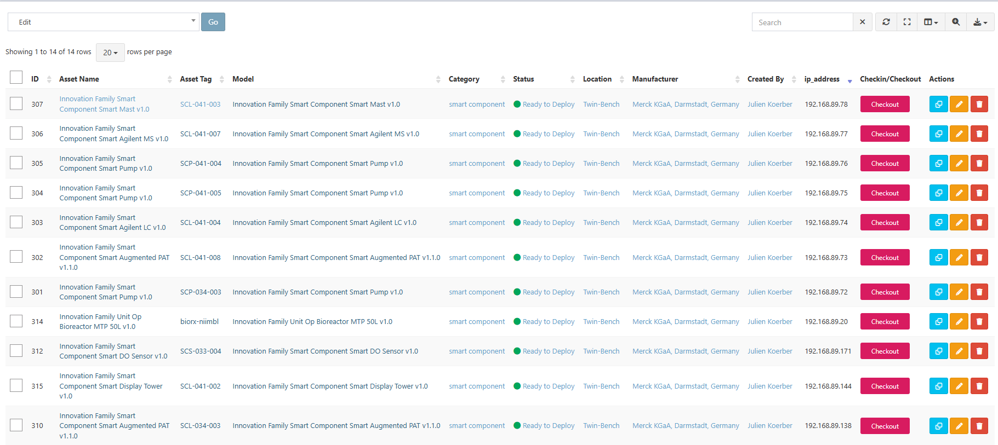
POC environnement
All these assets were discovered on the Twin-Bench, and the script retained their model, manufacturer, and IP address. We can choose to display them on the API.

Slide 19
Next Steps…

Slide 20
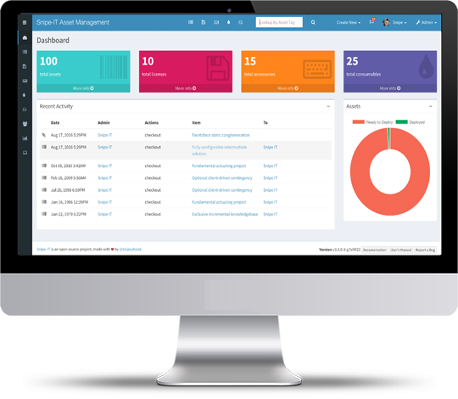



Have a Broader View
Make the MTP files of the SC appear in Snipe-it
Twin
Bench
3PEA
Bench
Dev
Bench
CCM
Bench
Use an LLM AI to better represent check-in check-out assets in Snipe-it.
Dockerize the script

Slide 21
Thank you everyone

